Slide 1

C O V A L A
Classroom Oriented Voice Activated Learning Assistant
By James Hodge, Bria Lowe, Christina Noe

Slide 2
P R O J E C T G O A L S
Create new voice commands for the Amazon Alexa that can be used in a classroom setting
Connect the software to Learning Management Systems to provide easy control over classroom records

Slide 3
F E A T U R E S
Roll Call - Take class attendance, repeat back attendance
Get Student Attendance - Ask for specific student’s attendance
Bonus Points - Give and remove cumulative bonus points
Timer - Set an alarm for a particular time
Online Student Table - View student attendance and bonus points

Slide 4
D E M O

Slide 5
S U M M A R Y
This project focused on adapting the Amazon Alexa technology from a home setting to a classroom setting by providing teachers with a hands free way of managing classroom records. We accomplished this with our Covala assistant application, which includes features that maintain attendance, record bonus points, and provide a timer for quizzes and exams. Possible future goals could be connecting the software to Learning Management Systems.

Slide 6
Q U E S T I O N S ?

Slide 7
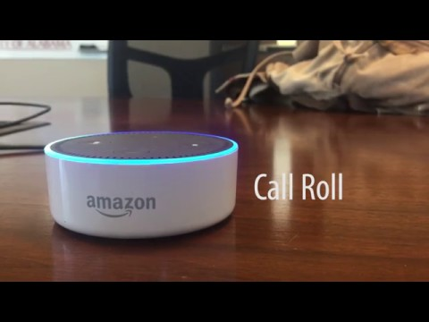
V I D E O

